Slide 1
Coffee Roaster Project
Arduino & Android

Slide 2
Overview
Arduino
ESP32
Android
Android studio

Slide 3
Goal
MAX 6675
Collecting temperature dynamically
ESP32s
Translate analogy signal change to digital
Via Bluetooth transmit data to phone
Android
Receive data from ESP32s
Show the curve visually
Start, Record temperature, End
Save file in local (.csv .jpg)

Slide 4
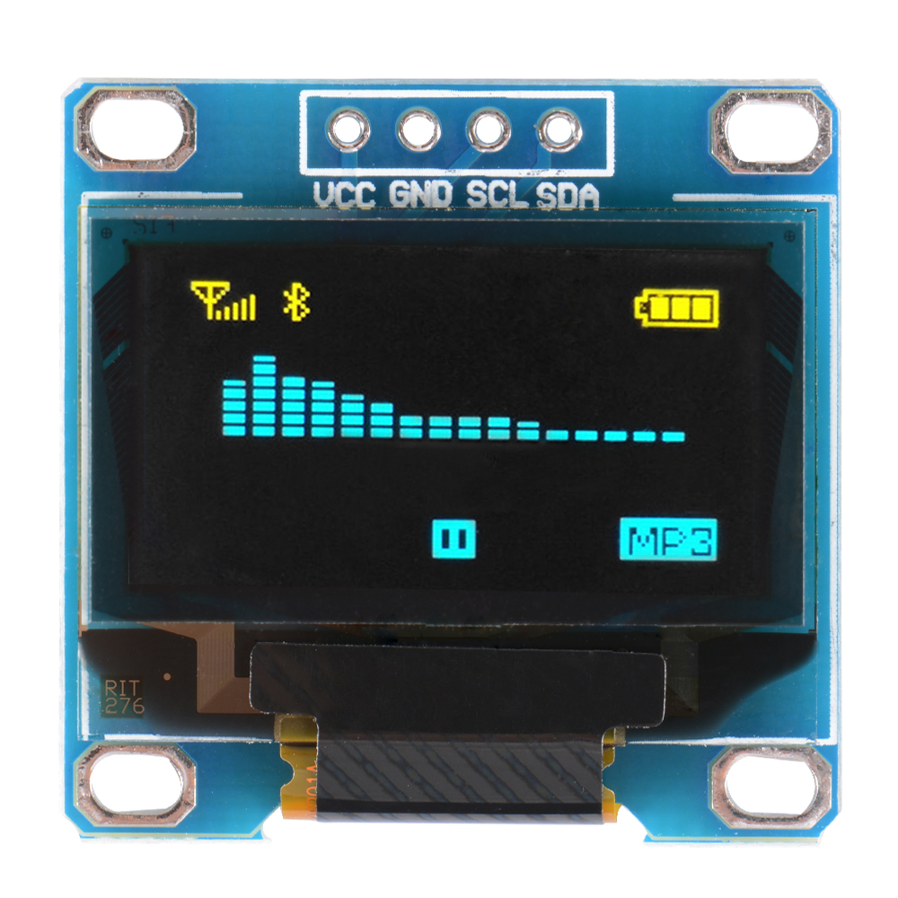
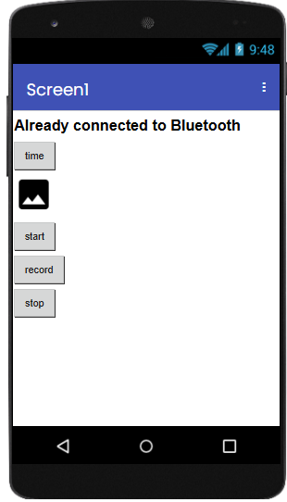

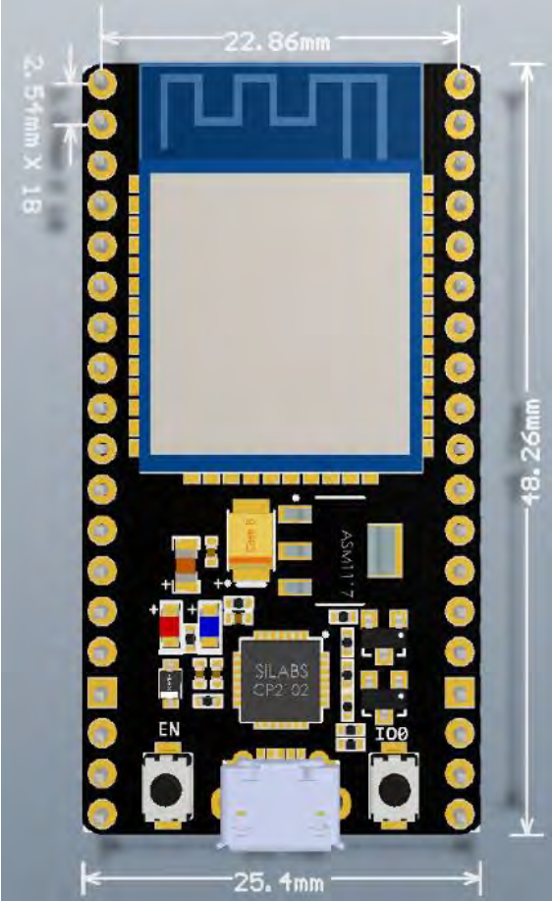
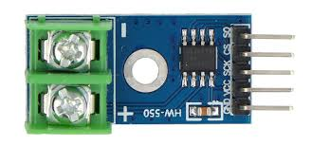
Layout
screen
MAX 6675
ESP32s
phone

Slide 5

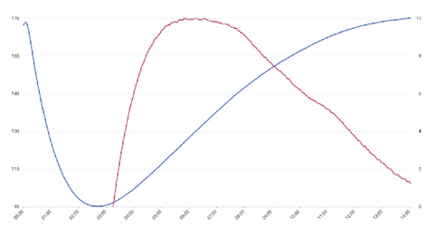

Flow
FileName
Folder
Find Bluetooh Device
Description
Save file
Bluetooth Adapter
Save file()
Bluetooth Socket
MSG: 23 °C
Input Stream
bluetoothSocket.getInputStream()
Geisha
saveFileActivity
updateLineChart()
start
record
stop
MAX 6675
ESP32s
Geisha
mainActivity
Description
Please get back to device !
blutoothOutOffRangeActivity
browseHistoryDataActivity

Slide 6
mainActivity
Geisha
Update linechart
Start
Draw
Start to count
Record
Draw temperature point
Stop
Stop to Draw
Stop to count
Jump to saveFileActivity
start
record
stop

Slide 7

saveFileActivity
FileName
Folder
filename
Type in
Folder
Show default folder in textbox
Can type directory directly or browse
Description
More blank option ? Ex. Region, Height, …
Description
Save file

Slide 8
bluetoothOutOffRangeActivity
Show warning view & counting down (cntDownPeriod = 15 sec ?)
Make warning sound
ESP32
Stored lost data in ESP32 (need SD card ?)
Decided how many storage need for exception data storage
If out off time, you will lose data
If recover, back to mainActivity and restored lost data
Please get back to device !

Slide 9
browseHistoryDataActivity
Geisha
Show title & lineChart & description
Press back-button back to mainActivity
Description

Slide 10
interface
Arduino & Android
Bluetooth interface

Slide 11
testcases
User out off Bluetooth range
Android: give caution closer to devices in case of losing data
Arduino: extra space to store the data when user out of range (SD card)
Need to deal with specific circumstance (還沒想到怎摩處理)

